Slide 1
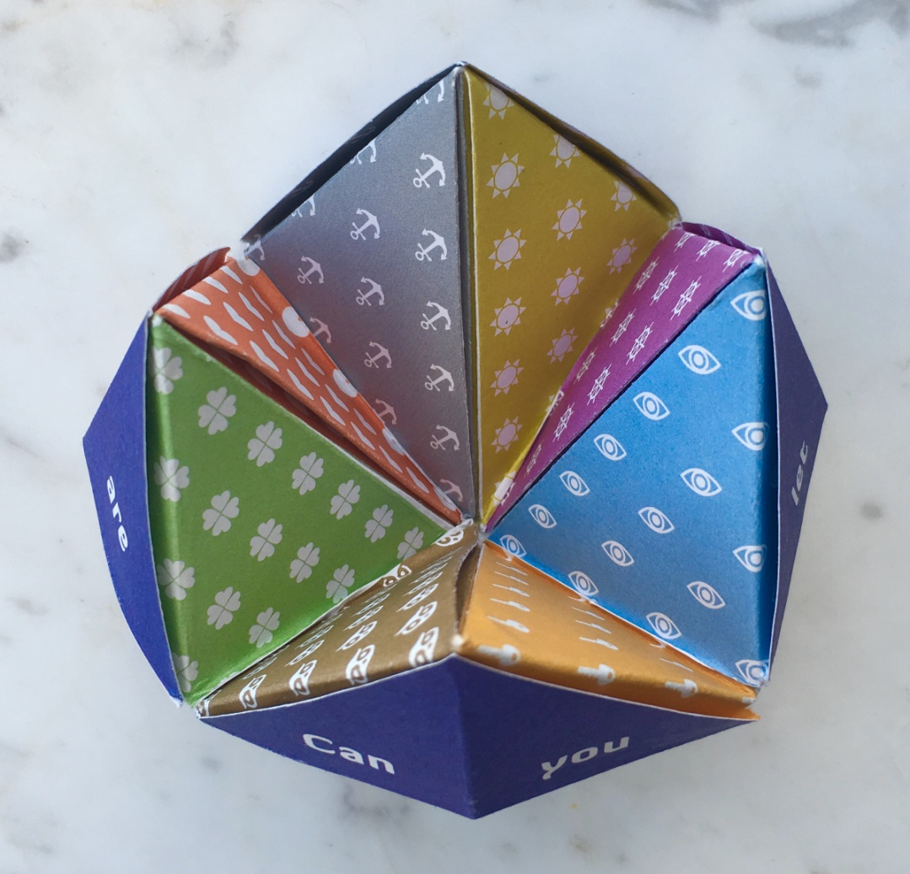
Fold the Chatterbox

Slide 2
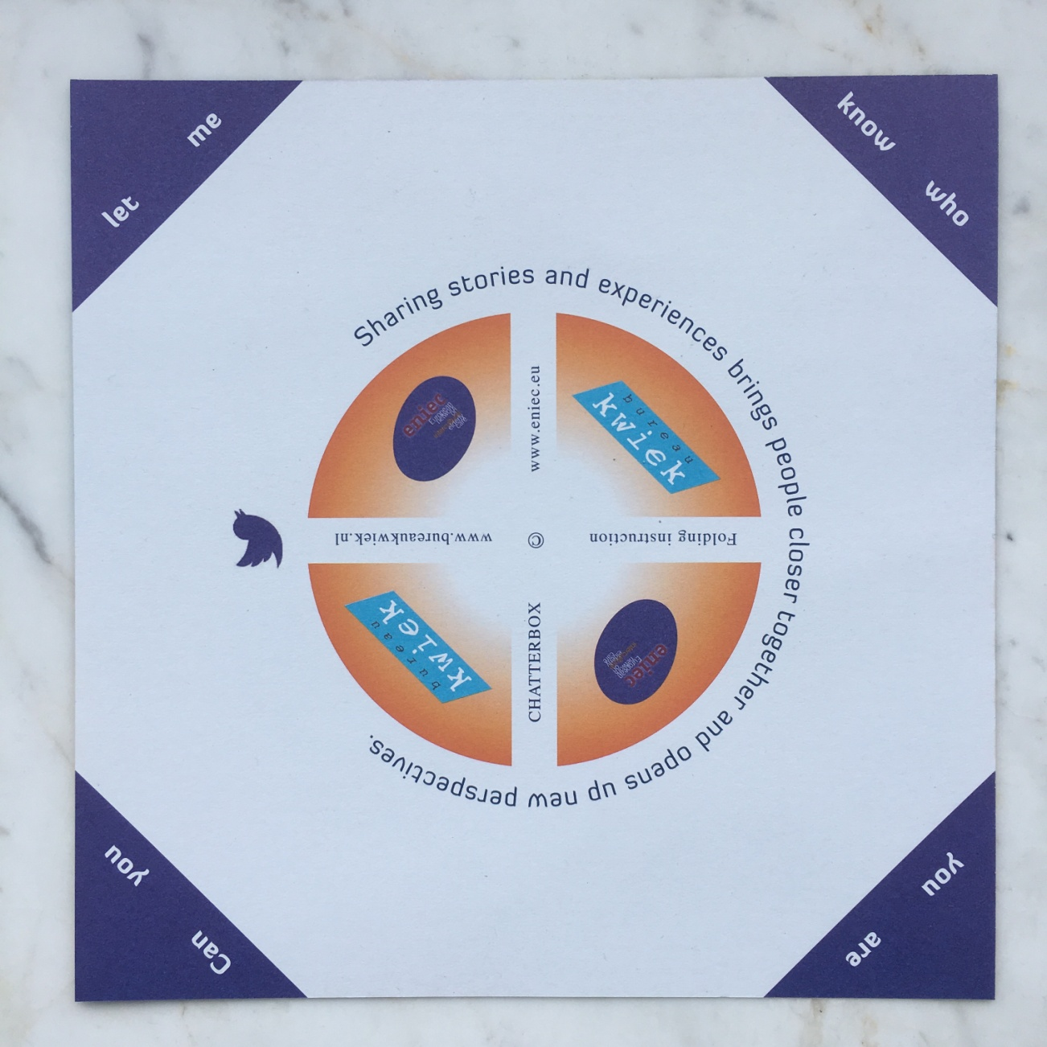
This side up

Slide 3
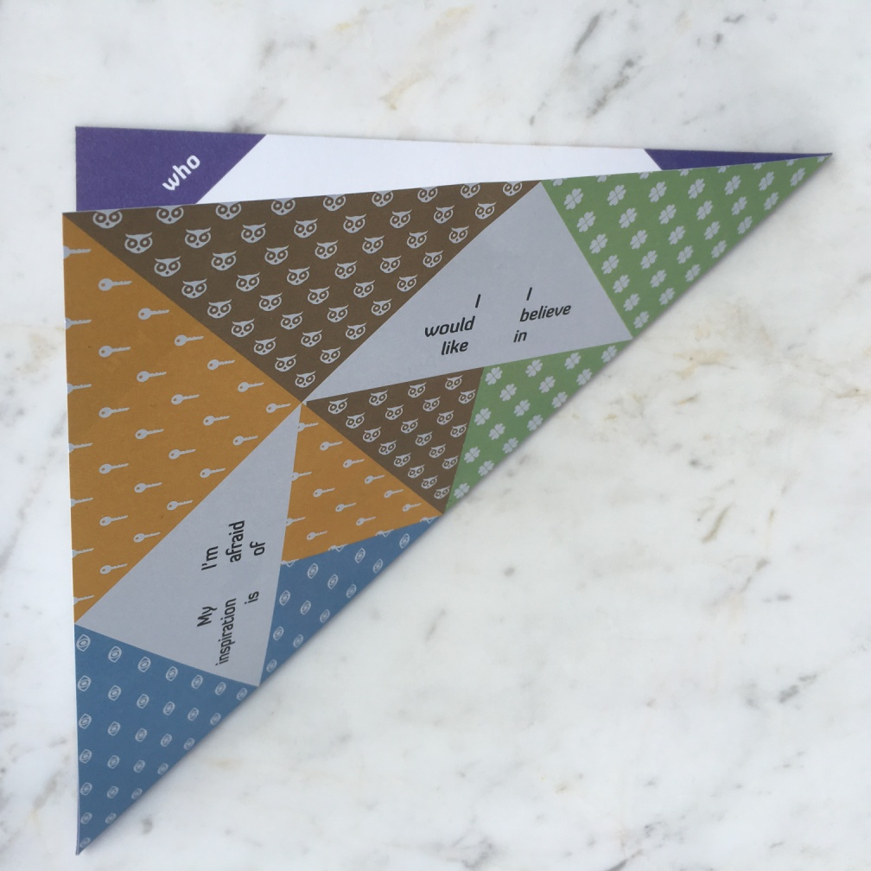
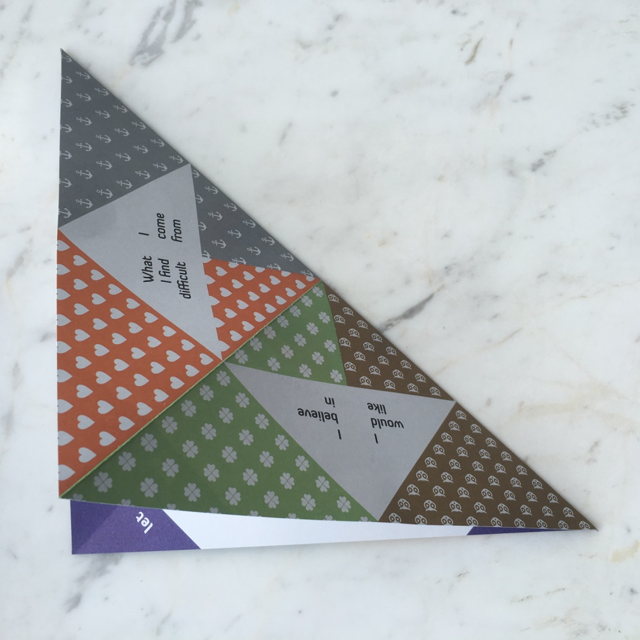
Fold diagonally first

Slide 4
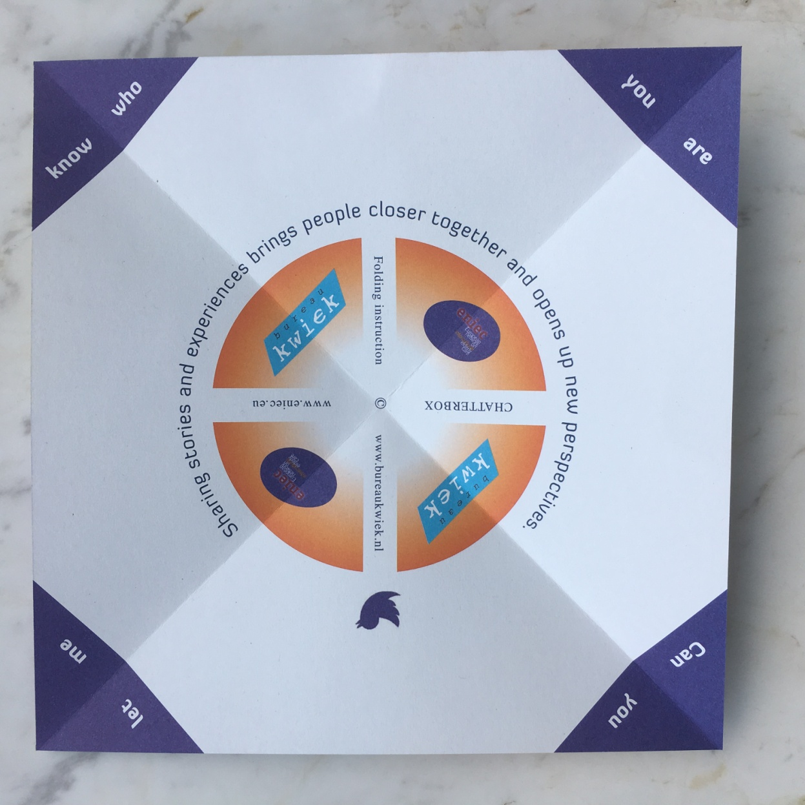
Folded diagonals

Slide 5
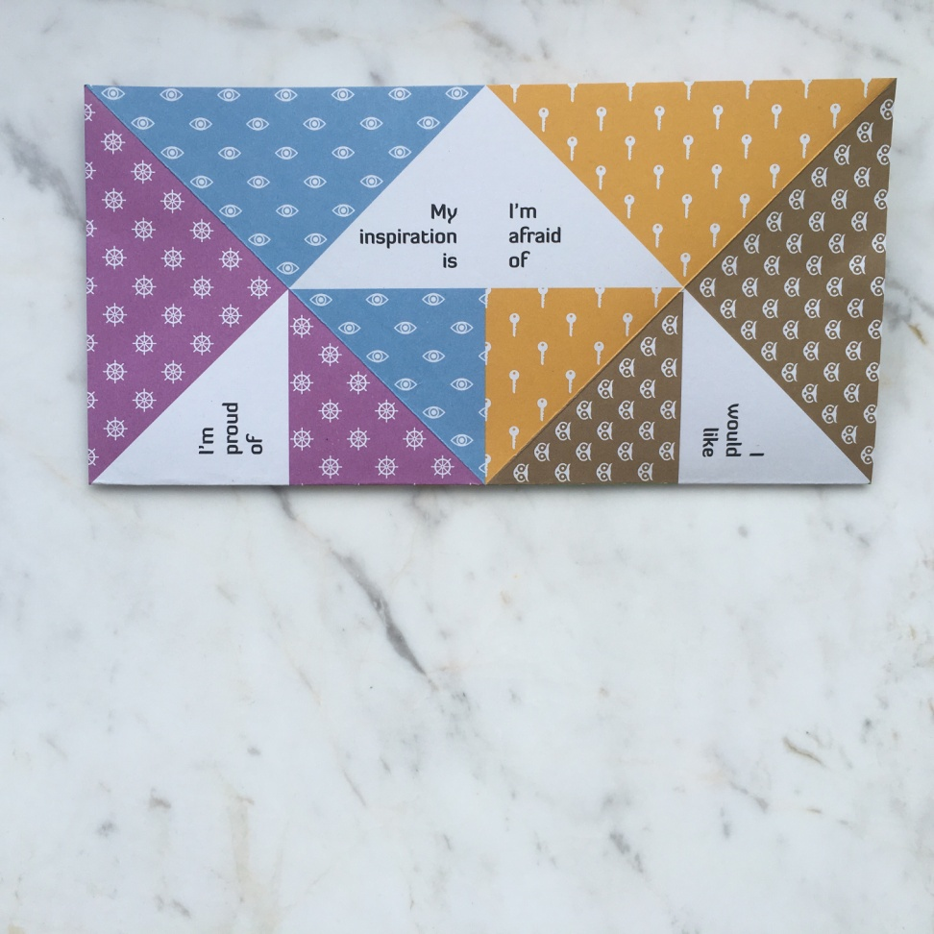
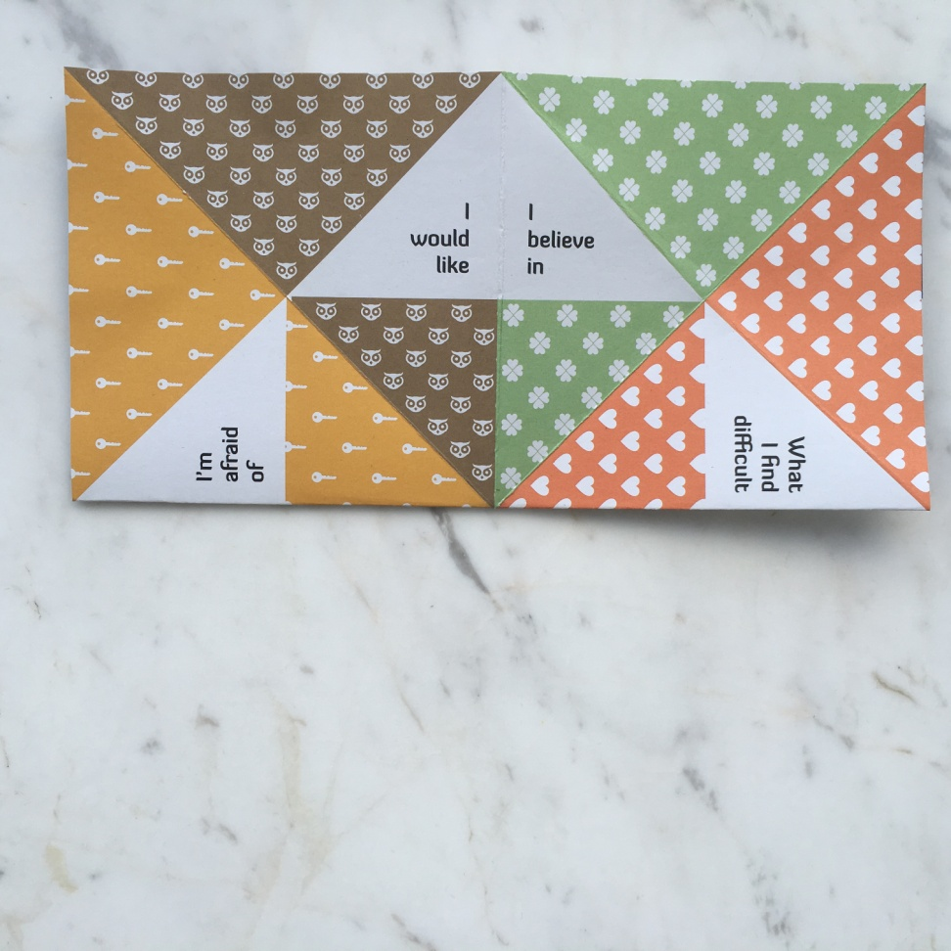
Fold the straight lines

Slide 6
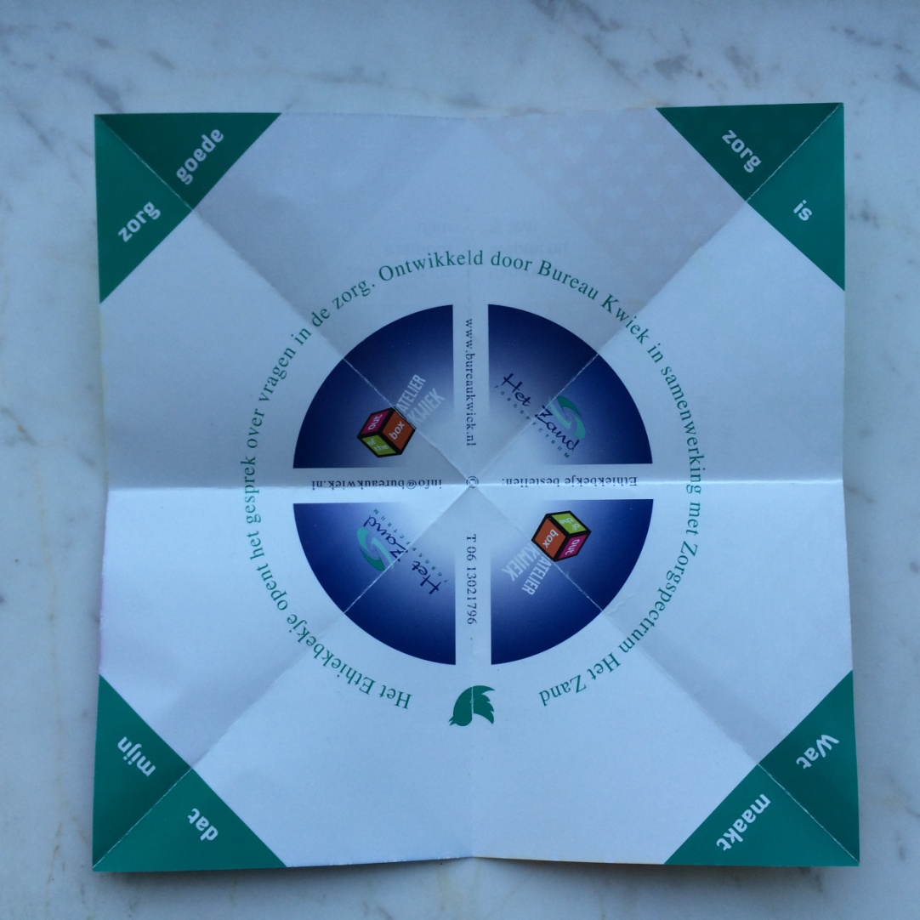
Fold lines

Slide 7
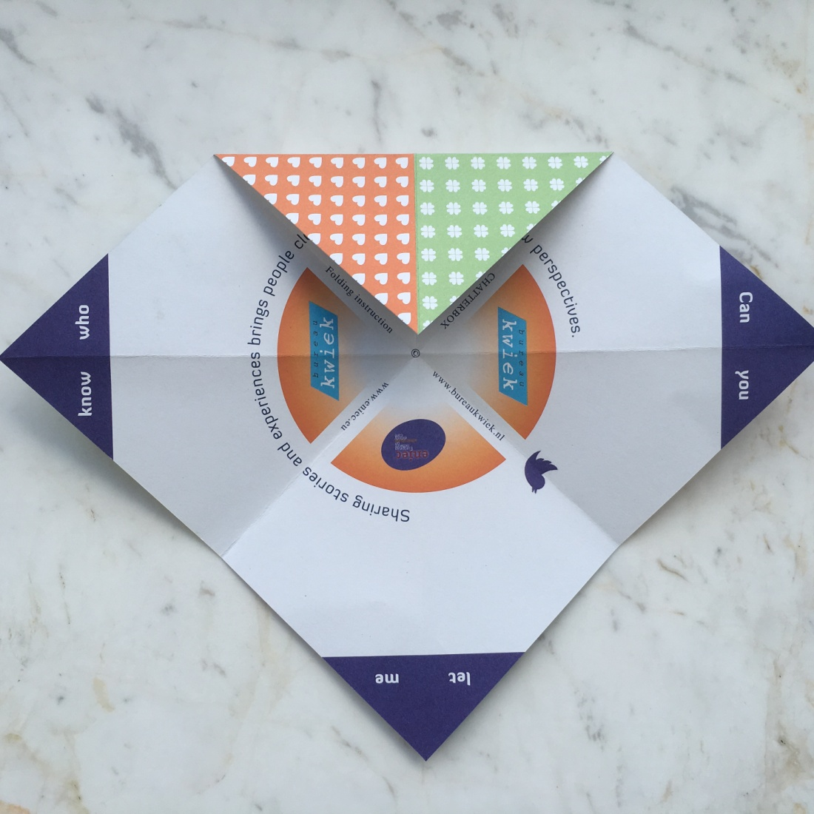
Fold the corners towards the centre

Slide 8
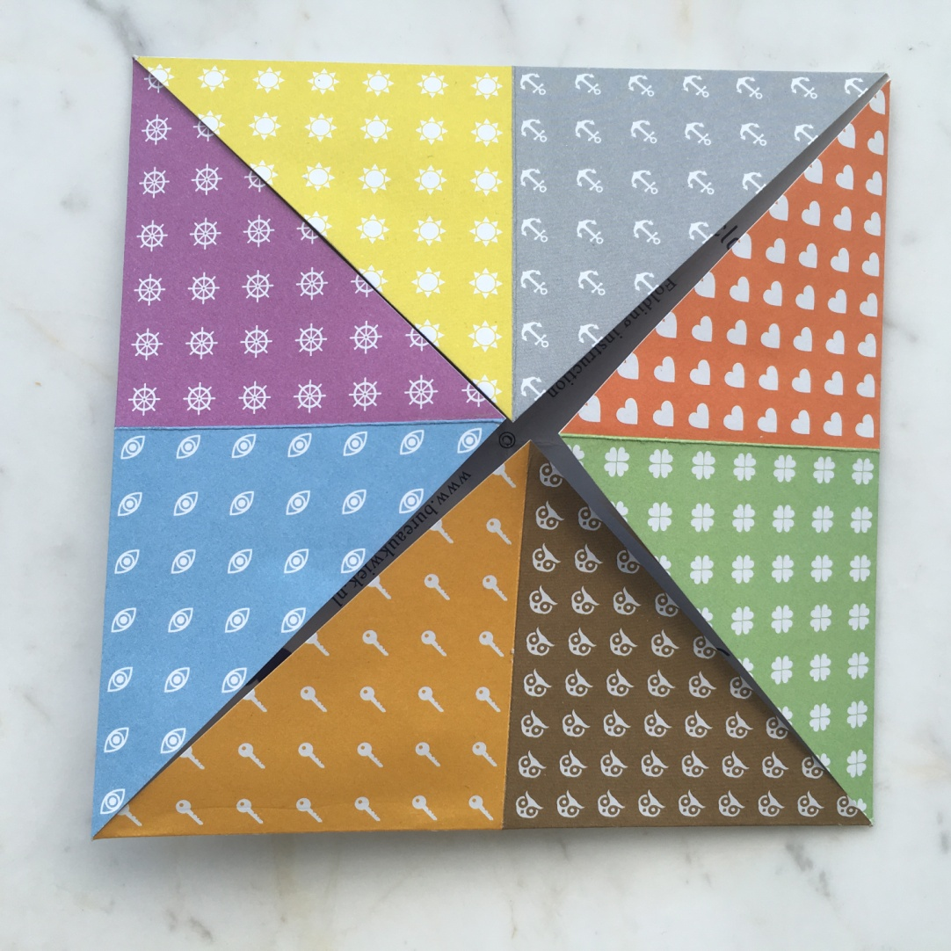
Repeat with all corners

Slide 9
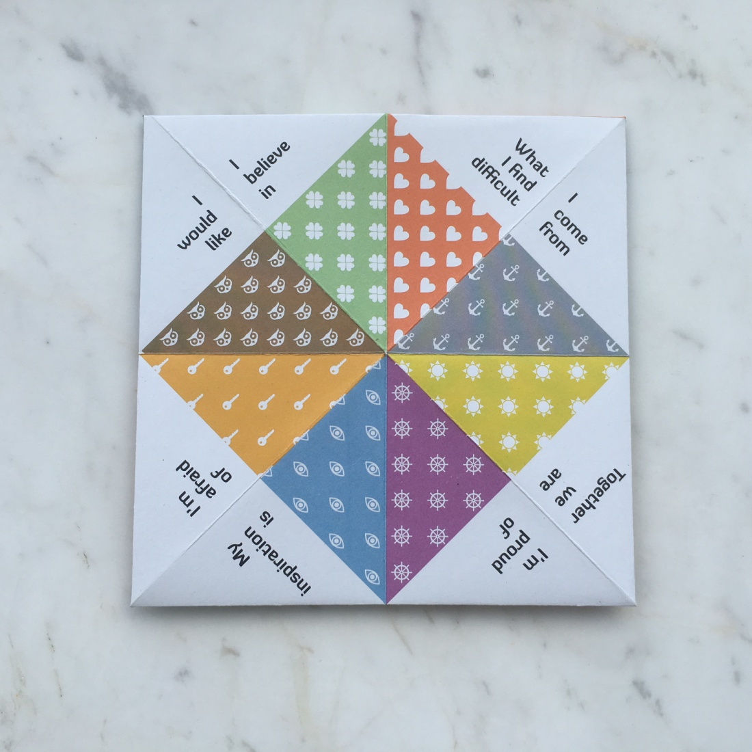
Turn it over

Slide 10
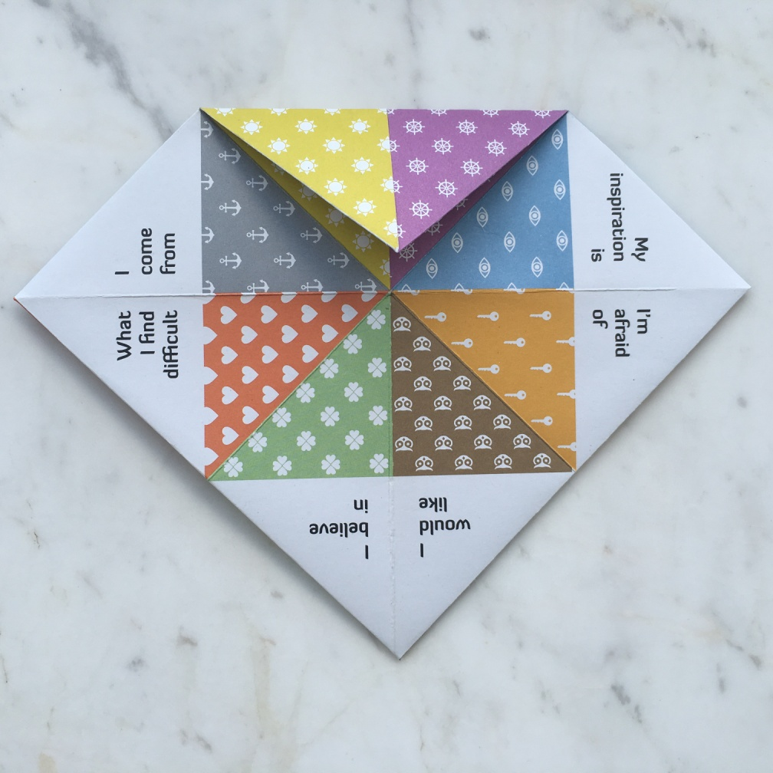
Fold the corners with text towards the centre

Slide 11
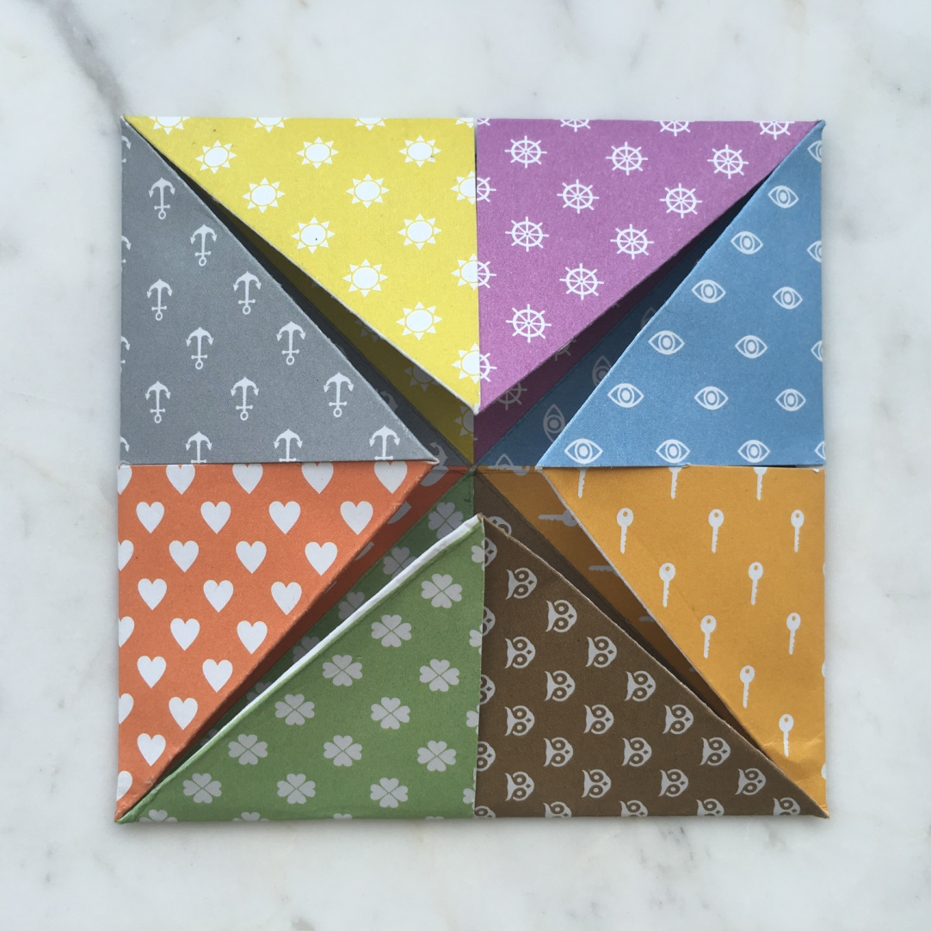
Do this with all the corners

Slide 12
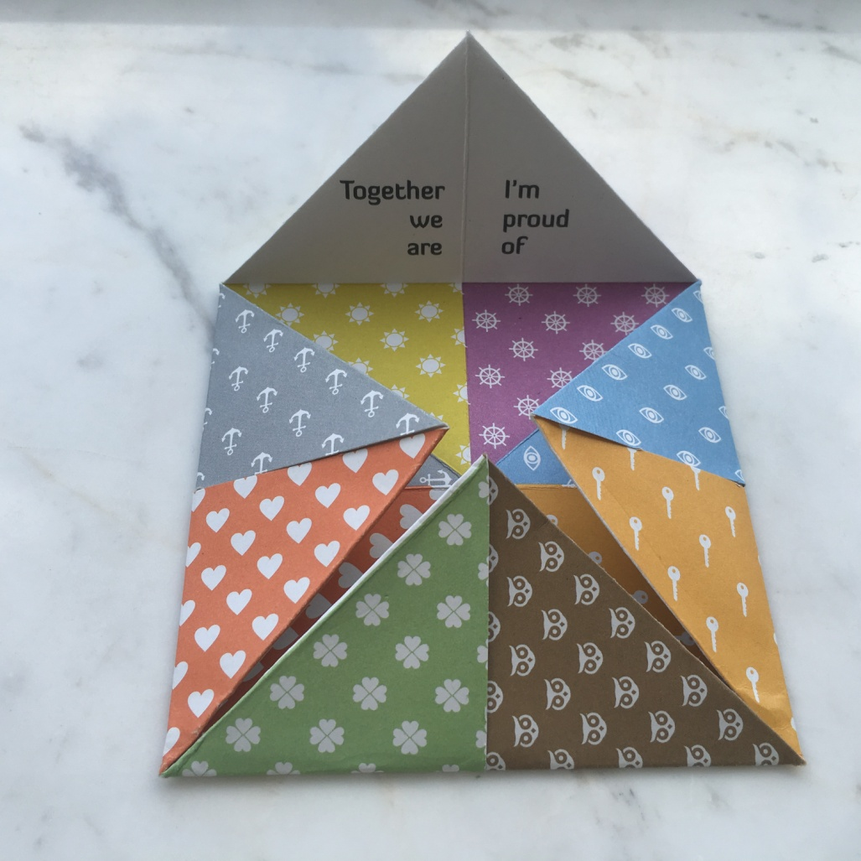
On the inner flap each colour and symbol now shows a question

Slide 13
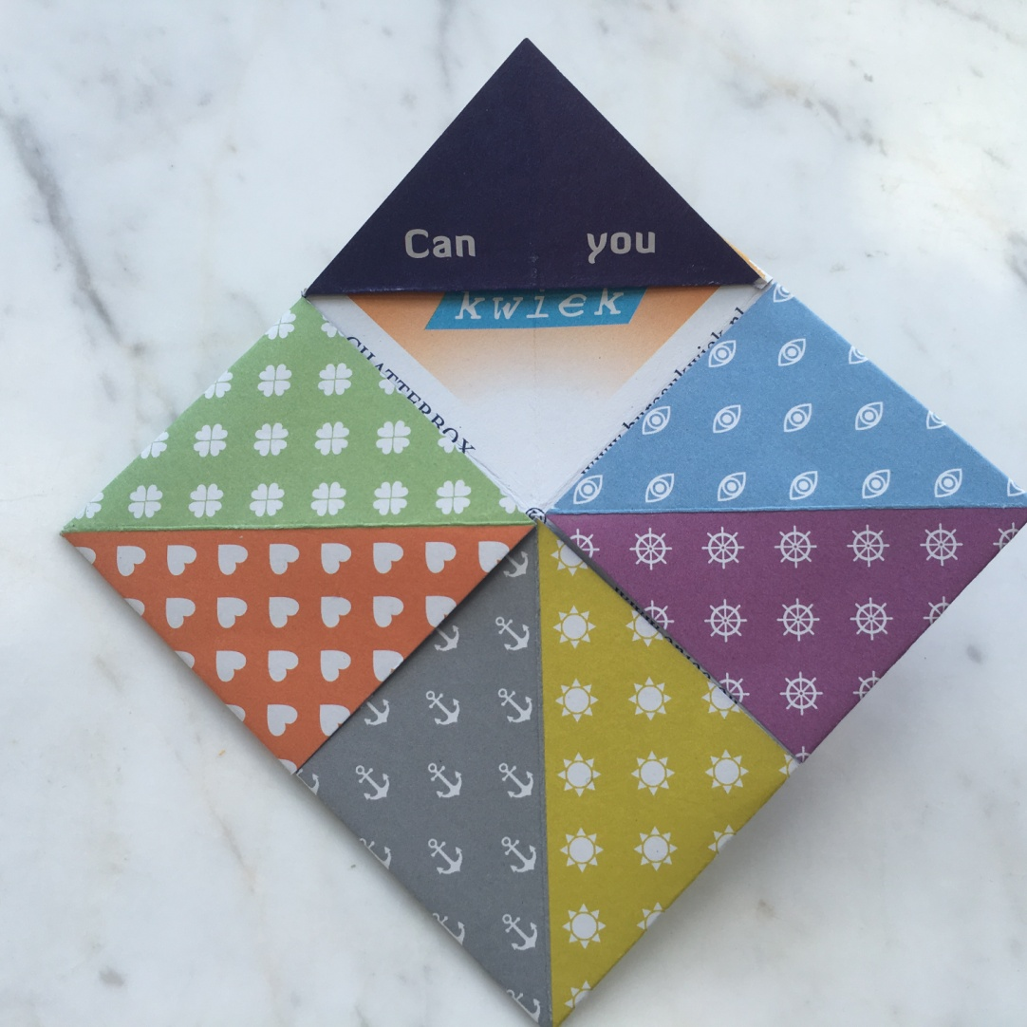
Turn it over and open the flaps outwards

Slide 14
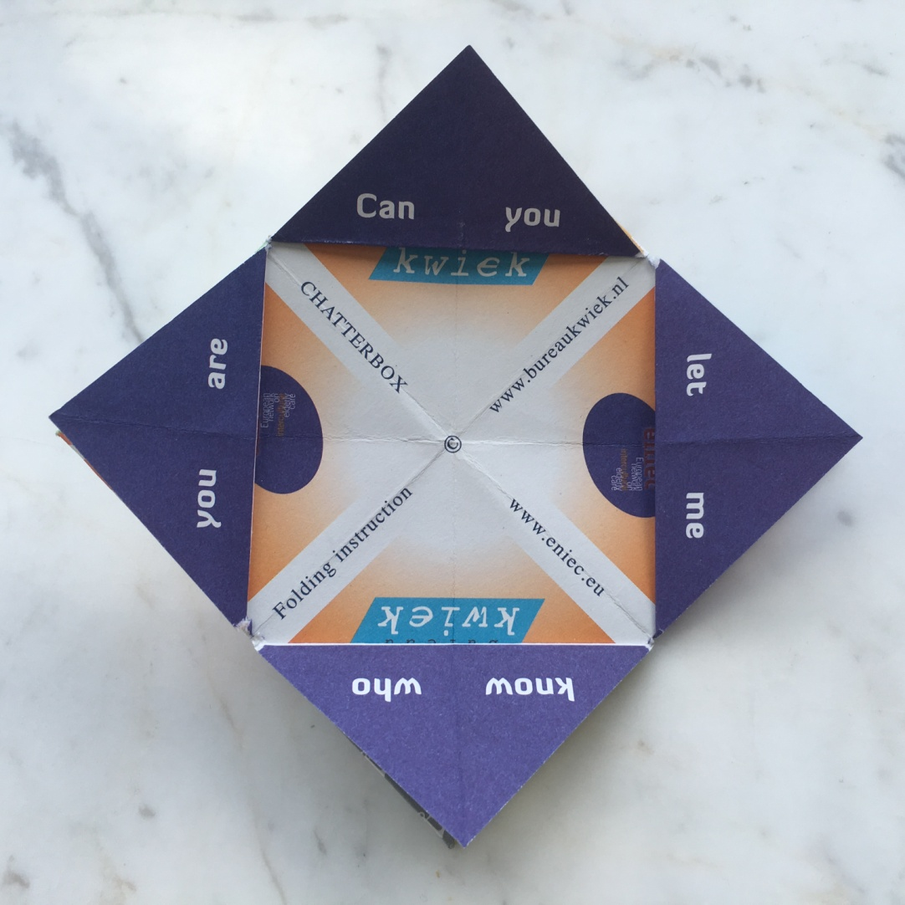
All flaps are opened outwards

Slide 15
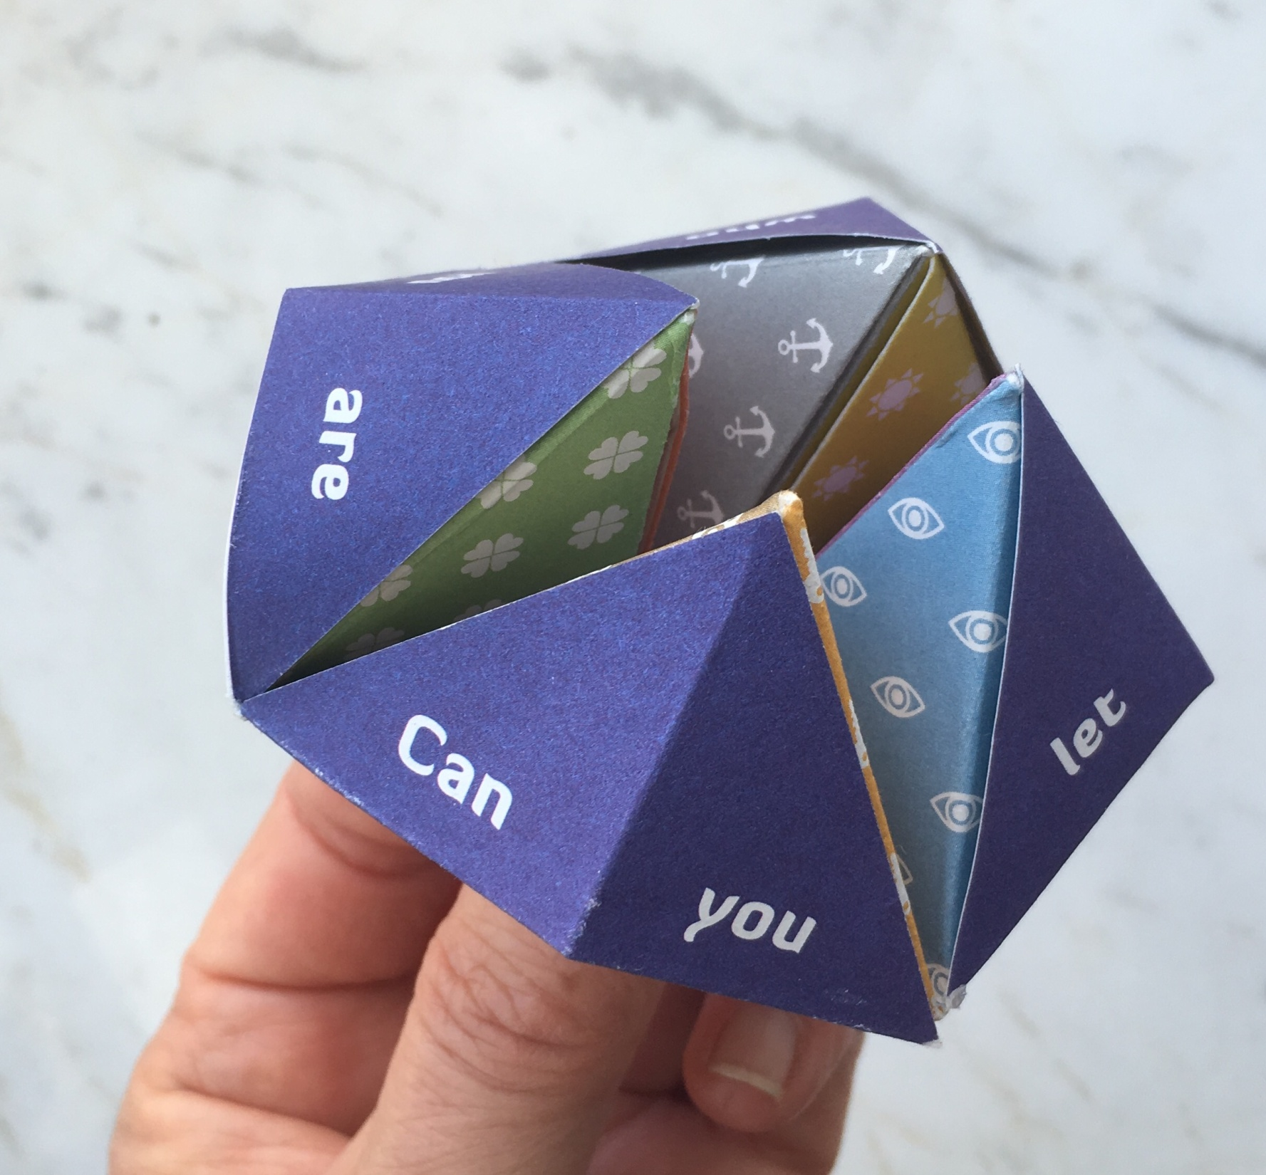
Place your fingers in the corners
.

Slide 16
Ask the other person to pick a number between 1-10 Open and close the chatterbox that amount of times

Slide 17
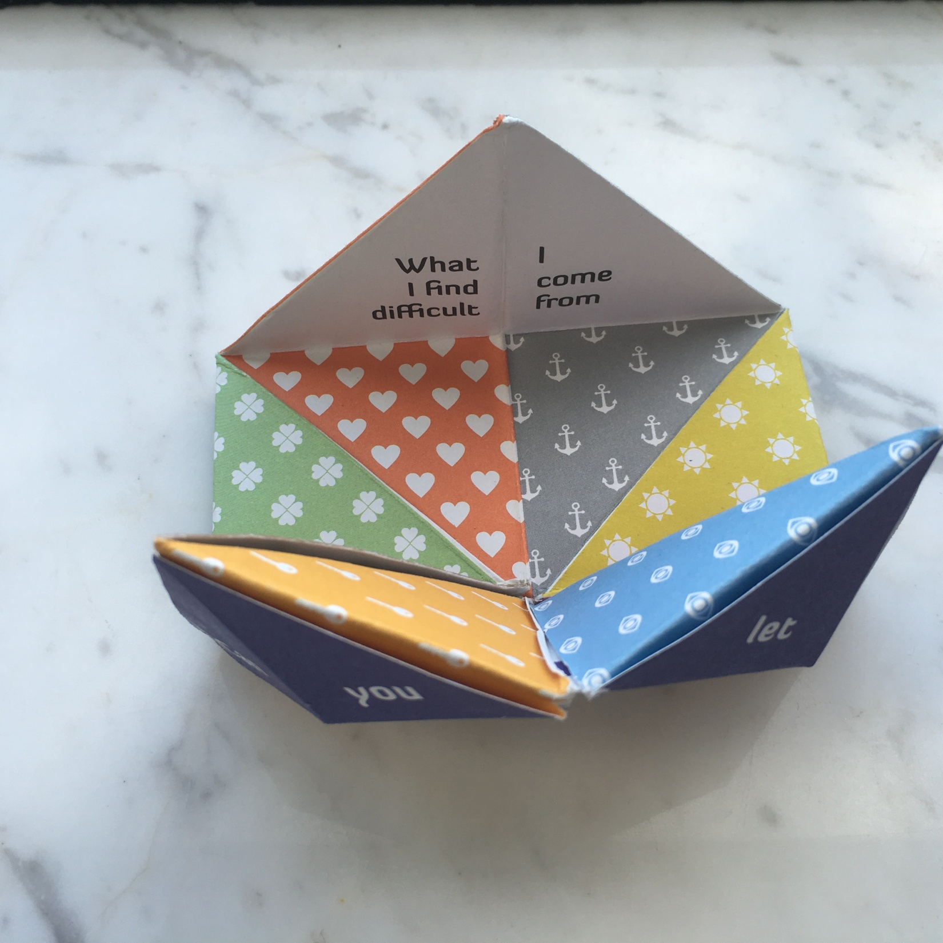
The other person then picks a colour or symbol. Ask the question under it.

Slide 18
The question leads to conversation. Keep asking questions!

Slide 19
Play, share your experiences and get to know each other.
Have fun!

